Slide 1
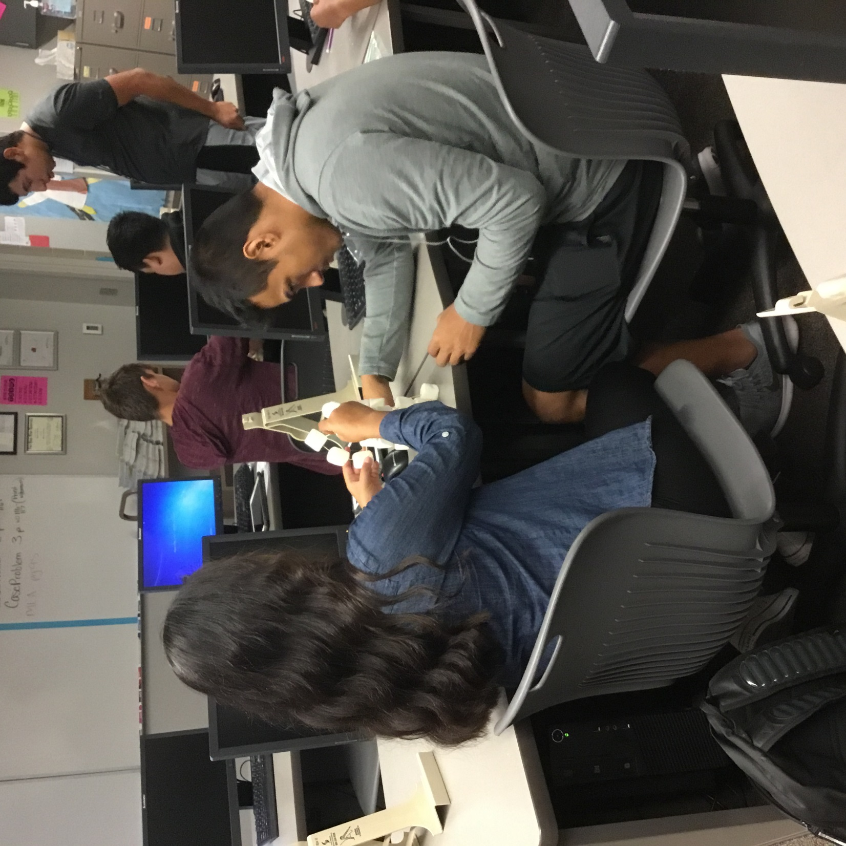
Marshmallow Tower Types of Business Ownership Project
This document was created by: Ember Dortch

Slide 2
TEACHER PAGE
Objective: Students will be able to identify the different types of business ownership and be able to compare and contrast the different types.
Materials needed (enough marshmallows for each group, this depends on class size), toothpicks, baggies, printed copies (below)
(**NOTE: With very few changes you can build with anything, Legos, cards, blocks, paper and paperclips, etc.)
Prep:
Put 15 marshmallows and 25 toothpicks in a baggie for each proprietorship and each person in a partnership
Put 60 marshmallows and 75 toothpicks in a baggie for each corporation
Print:
1 copy of page 3 *(If you are having students draw. You may put students in groups if you’d rather.)
1 copy of page 5 for each group (maybe 2 or 3 extras so everyone can look at a paper)
Print 1 copy of pages 6-11 (one per group)
Review:
The resources available and requirements for each type of business. (Page 5)
Have students draw for their groups or assign them
Pass out pages 6-11
Set a timer for 15-20 minutes
When time is up measure the towers and debrief
Which tower was tallest?
What factors affected the outcome?
Which business type was the easiest?
Which was the most difficult?
Assign Reflection questions to add a written component.

Slide 3
Proprietorship | Proprietorship | Partnership #1 | Partnership #1
Partnership #2 | Partnership #2 | Partnership #2 | Corporation
Corporation | Corporation | Corporation | Corporation
Corporation | Corporation | Corporation | Corporation
Corporation | Partnership #3 | Partnership #3 | Partnership #3

Slide 4
Group Assignment Sheets
Proprietorship
Proprietorship
Partnership #1
Partnership #2
Partnership #3
Corporation
Proprietorship
Proprietorship
Partnership #1
Partnership #2
Partnership #3
Corporation

Slide 5
Proprietorships
Objective:
Build the tallest tower using the resources you have available to you (Towers will be measured from the base of the structure to the top of the structure.)
Human Resources:
1 person
Capital Resources:
15 marshmallows and 25 toothpicks
Requirements:
Must “register” company name before building
(You will get your supplies when you hand this in to the teacher)
PARTNERSHIPS
Objective:
Build the tallest tower using the resources you have available to you (Towers will be measured from the base of the structure to the top of the structure.)
Human Resources:
2-3 people
Capital Resources:
15 marshmallows and 25 toothpicks per person
Requirements:
Must register company name and partnership agreement before building. (You will get your supplies when you hand this to your teacher)
CORPORATION
Objective:
Build the tallest tower using the resources you have available to you (Towers will be measured from the base of the structure to the top of the structure.)
Human Resources:
10-12 people
Capital Resources:
60 marshmallows and 75 toothpicks
Requirements:
Must “register” company name
Must complete articles of incorporation
Must name a board of directors of at least 6 people
Board of Directors must designate 2 chief builders and vote on it
(You will get your supplies when you hand this to your teacher)
Must follow the chain of command (BOD > CEO > BUILDERS)

Slide 6
Student Name: ___________________ Business Name: ___________________
PROPRIETORSHIP #1
Student Name: ___________________ Business Name: ___________________
PROPRIETORSHIP #2

Slide 7
Partner #1 Name: _____________________________ Partner #2 Name: ______________________________ 1. Type of Business. The Partners voluntarily associate themselves together as general partners for the purpose of conducting the general business of _______________________________________, and any other type of business that may from time to time be agreed on by the Partners. 2. Name of Partnership. 2. The name of the Partnership shall be ____________________________________________ __________________________________. This name will be registered in the office of the Secretary of State as the fictitious name of the Partnership. 3. Term of Partnership. The Partnership shall commence on_________________________________ and shall continue until ________________________________________________________ or terminated as provided in this Agreement. 4. Place of Business. The principal place of business of the Partnership shall be at ________________________________________________________, and any other place or places that may be mutually agreed on by the parties to this Agreement.
PARTNERSHIP #1

Slide 8
Partner #1 Name: _____________________________ Partner #2 Name: ______________________________ Partner #3 Name: ______________________________ 1. Type of Business. The Partners voluntarily associate themselves together as general partners for the purpose of conducting the general business of _______________________________________, and any other type of business that may from time to time be agreed on by the Partners. 2. Name of Partnership. 2. The name of the Partnership shall be ____________________________________________ __________________________________. This name will be registered in the office of the Secretary of State as the fictitious name of the Partnership. 3. Term of Partnership. The Partnership shall commence on_________________________________ and shall continue until ________________________________________________________ or terminated as provided in this Agreement. 4. Place of Business. The principal place of business of the Partnership shall be at ________________________________________________________, and any other place or places that may be mutually agreed on by the parties to this Agreement.
PARTNERSHIP #2

Slide 9
Partner #1 Name: _____________________________ Partner #2 Name: ______________________________ Partner #3 Name: ______________________________ Partner #4 Name: ______________________________ 1. Type of Business. The Partners voluntarily associate themselves together as general partners for the purpose of conducting the general business of _______________________________________, and any other type of business that may from time to time be agreed on by the Partners. 2. Name of Partnership. 2. The name of the Partnership shall be ____________________________________________ __________________________________. This name will be registered in the office of the Secretary of State as the fictitious name of the Partnership. 3. Term of Partnership. The Partnership shall commence on_________________________________ and shall continue until ________________________________________________________ or terminated as provided in this Agreement. 4. Place of Business. The principal place of business of the Partnership shall be at ________________________________________________________, and any other place or places that may be mutually agreed on by the parties to this Agreement.
PARTNERSHIP #3

Slide 10
List least 6 Board of Directors: Articles of Incorporation: Article I: Type of business: The purpose of conducting the general business of ______________________________________, and any other type of business that may from time to time be agreed on by the board of directors. Article II: Name of the business shall be ____________________________________________. This name will be registered in the office of the Secretary of State as the fictitious name of the corporation. Article III: Board of Directors shall serve a ___________________term. The company should have at least 6 board of directors listed. Article IV: Place of Business. The principal place of business of the Partnership shall be at ________________________________________________________, and any other place or places that may be mutually agreed on by the parties to this Agreement. By Laws: 1. Only the chief builders (______________________________________ and ____________________________________________) should construct the tower. 2. All decisions must be voted on by the board of directors. 3. A written log of all construction decisions and the vote must be handed in at the end of class 4. All decisions must follow the chain of command. Members may make suggestions to the BOD who will vote and let the CEO know of the decision who will pass it along to the builders. Signed: CEO: __________________________________________ Chairman of the Board: _______________________________________
CORPORATION

Slide 11
Board of Directors Voting Sheet
Decision | Yes? | No?

Slide 12
REFLECTION QUESTIONS
•Paragraph 1:
What type of business were you assigned to?
What were the advantages and disadvantages?
What were your struggles?
What were your successes?
•Paragraph 2:
If you were to do this activity again, which type of ownership would you rather have? Why?
What advantages and disadvantages did other teams have?
•Paragraph 3:
What did you learn?
Compare and Contrast each type of ownership.

